Slide 1
Introduction to Anticoagulation
Carlin Rooke, MD
July 27, 2018

Slide 2
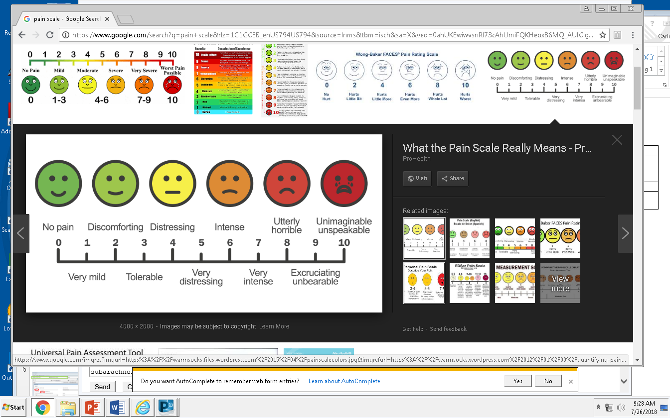
Pain Scale Jeopardy
Discomforting
Distressing
Intense
Utterly horrible
$100
$200
$300
$400
$100
$200
$300
$400
$100
$200
$300
$400
Final Jeopardy

Slide 3
Level 1:
Discomforting

Slide 4
Level 2:
Distressing

Slide 5
Level 3:
Intense

Slide 6
Level 4:
Utterly Horrible

Slide 7
$100 – Clinic Referrals
What is the correct way to refer a patient to anticoagulation clinic?

Slide 8
What is the correct way to refer a patient to anticoagulation clinic?
  ORCHID message to Dr. Rooke
  ORCHID message to Coumadin message pool
  Send a carrier pigeon to room 2D-152
  Phone or page Dr. Rooke directly

Slide 9
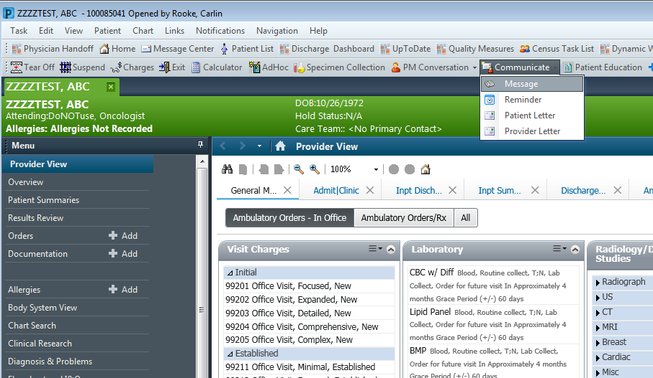

Slide 10
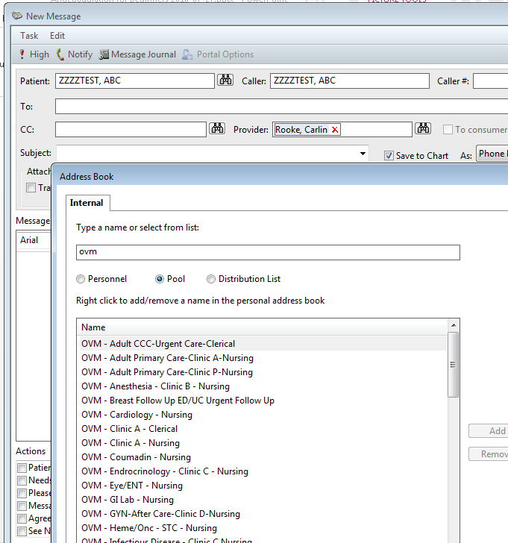

Slide 11
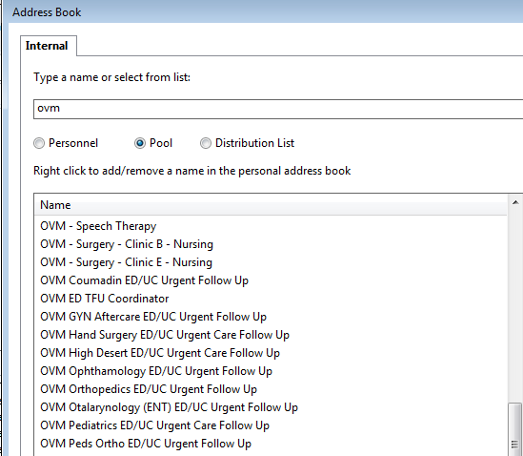
OVM Coumadin ED/UC Urgent Follow Up

Slide 12
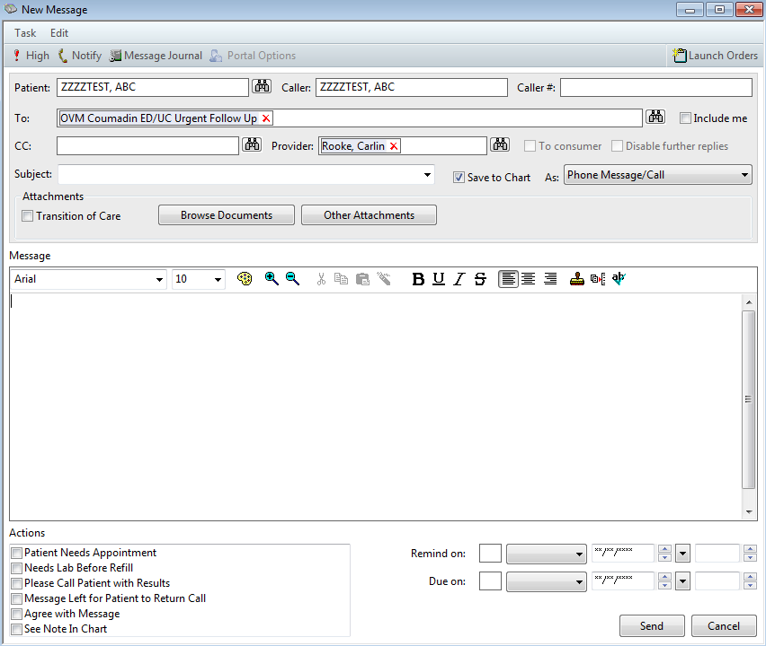

Slide 13
$100 – starting warfarin
When starting warfarin in the outpatient setting:
What is the usual starting dose?
How much medication should be provided?

Slide 14
When starting warfarin in the outpatient setting:
- What is the usual starting dose?
- How much medication should be provided?
  Starting Dose:
  1mg
  2.5mg
  5mg
  10mg
  Supply:
  3 days
  10-14 days
  30 days
  90 days

Slide 15
$100 – Access to DOACs
Which insurance status prevents a patient from access to rivaroxaban and/or apixaban at the OVMC pharmacy?

Slide 16
Which insurance status prevents a patient from accessing rivaroxaban and/or apixaban at the OVMC pharmacy?
  DHS Medi-Cal Managed Care
  IHSS (In-Home Supportive Services)
  Non-DHS Medi-Cal Managed Care
  ATP/Charity
  None of the above

Slide 17
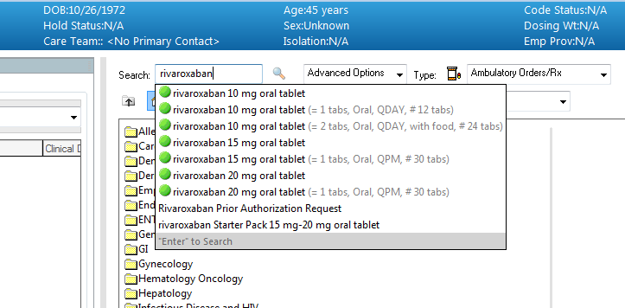
Prior Authorization

Slide 18
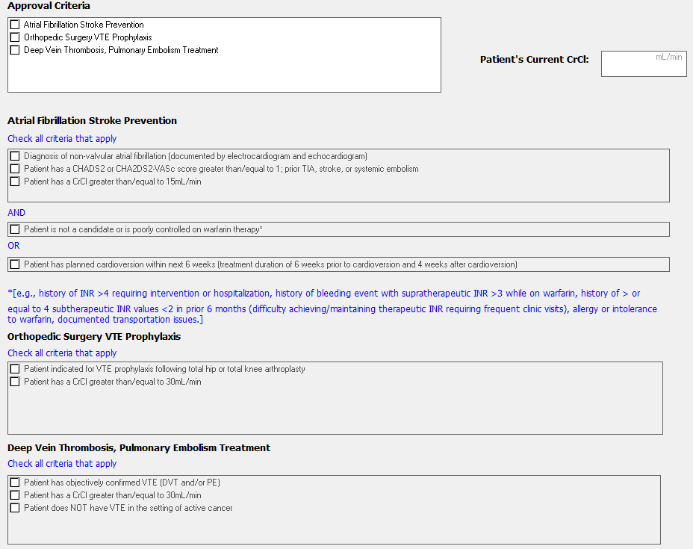

Slide 19
$200 – Surgically provoked DVT
If a patient develops a DVT within 3 months of having major surgery, what is the most appropriate treatment?

Slide 20
If a patient develops a DVT within 3 months of having major surgery, what is the most appropriate treatment?
  Rivaroxaban for 3 months
  Rivaroxaban for 6 months
  Rivaroxaban indefinitely
  Warfarin for 3 months (with initial lovenox bridging)
  Warfarin for 6 months (with initial lovenox bridging)
  Warfarin indefinitely (with initial lovenox bridging)

Slide 21
Risk of recurrent VTE after surgically-provoked VTE
 | 1 yr | 5 yrs
Surgical provoking factor | 1% | (0.5%/yr)

Slide 22
$200 – Nonvalvular AFib
Which of the following patients must be treated with warfarin, (not rivaroxban or apixaban)?

Slide 23
Which of the following patients must be treated with warfarin (not rivaroxaban or apixaban)?
  47 Y W with paroxysmal Afib and moderate mitral stenosis
  64 Y M with permanent Afib and aortic sclerosis
  75 Y M with paroxysmal Afib and mitral valve prolapse

Slide 24
Valvular Atrial Fibrillation
  Inconsistent definition, but always includes:
    Mitral valve stenosis
    Rheumatic heart disease
  Warfarin is superior to DOAC therapy

Slide 25
$200 – Malignancy-associated VTE
A patient is found to have a DVT of her left popliteal vein. She is also receiving chemotherapy and radiation for cervical cancer. What is the most effective anticoagulant?

Slide 26
What is the most effective anticoagulant for treating malignancy-associated DVT?
  Lovenox
  Warfarin (with initial lovenox bridge)
  Rivaroxaban or apixaban
  IV unfractionated heparin

Slide 27
Recurrence of VTE with malignancy
CLOT trial warfarin (17%) vs dalteparin (9%)
LITE trial warfarin (16%) vs tinzaparin (7%)
No data for novel oral anticoagulants

Slide 28
$300 – New onset Afib
A 54 year old man with hypertension presents to his primary care appointment. He feels well.
On physical exam, he is found to have an irregularly irregular heart rate.
EKG confirms atrial fibrillation with rate of 84 bpm.
What is the best strategy for anticoagulation?

Slide 29
What is the best anticoagulation strategy for this patient’s new onset atrial fibrillation?
  Start oral rivaroxaban (and refer to anticoagulation clinic)
  Start oral warfarin (and refer to anticoagulation clinic)
  Prescribe oral warfarin with lovenox bridging (and refer to anticoagulation clinic)
  Admit to hospital for warfarin with IV unfractionated heparin bridging (and refer to anticoagulation clinic at discharge)

Slide 30
When does new onset atrial fibrillation require lovenox or heparin?
  Patient is not a candidate for DOAC, and
Absolute indications
  Electric cardioversion is planned/desired
  Cardiac thrombus is present
  Patient requires amiodarone (potential for chemical cardioversion)
  Patient has very high CHADSVASC score (6-8?)
  Patient has known valvular heart disease
Debatable indications

Slide 31
$300 – New Onset AFib
A 50 year-old woman with hypertension and latent TB infection presents to a regular primary care appointment.
On physical exam, she is found to have an irregularly irregular heart rate. EKG confirms atrial fibrillation with a rate in the 70’s.
Her medications include amlodipine for hypertension and isoniazid/rifampin for latent TBI.
What is the best anticoagulation strategy for this patient?

Slide 32
What is the best anticoagulation strategy for this patient’s new onset atrial fibrillation?
  Start oral rivaroxaban (and refer to anticoagulation clinic)
  Start oral warfarin (and refer to anticoagulation clinic)
  Prescribe oral warfarin with lovenox bridging (and refer to anticoagulation clinic)
  Admit to hospital for warfarin with IV unfractionated heparin bridging (and refer to anticoagulation clinic at discharge)

Slide 33
Beware drug-drug interactions with Xa inhibitors
Dual inhibitors of CYP450 (3A4) and P-glycoprotein
Strong CYP450 (3A4) Inducers
Boceprevir
Clarithromycin
Cobicistat
Conivaptan
Darunavir
Indinavir
Itraconazole
Ketoconazole
Lopinavir
Nelfinavir
Nicardipine
Posaconazole
Ritonavir
Saquinavir
Telaprevir
Telithromycin
Carbamazepine
Enzalutamide
Fosphenytoin
Nevirapine
Oxcarbazepine
Pentobarbital
Phenobarbital
Phenytoin
Primidone
Rifabutin
Rifampin
Rifapentine

Slide 34
More efficient “brain storage”
Dual inhibitors of CYP450 (3A4) and P-glycoprotein
Strong CYP450 (3A4) Inducers
ID Drugs
(especially HIV and antifungal)
TB drugs and antiepileptics

Slide 35
What is the cost to DHS for one year of outpatient rivaroxaban therapy for one patient?
  $1100
  $4000
  $5500
  Depends on the patient’s insurance status
  Depends on where the medication is prescribed (ie: OVMC vs Mid Valley)
  Depends on which pharmacy the patient uses (ie: DHS vs non-DHS)

Slide 36
$300 – Acute DVT
A 32 year old man presents to the ED with two days of warmth, swelling, and tenderness of his right calf and thigh.
Ultrasound shows a DVT of the right femoral and popliteal veins.
He has no known medical problems, and he takes no medications. No recent surgeries or immobilization.
He is started on subcutaneous lovenox and warfarin. How long should warfarin and lovenox be continued?

Slide 37
Treatment with warfarin for acute, unprovoked DVT
Duration of lovenox
Duration of warfarin
5 days
Until INR is therapeutic
5 days and until INR is therapeutic
3 months, then stop
3 months, then have a risk/benefit discussion with the patient
6 months, then stop
Indefinite

Slide 38
“Overlap” versus “Bridging”
Overlap therapy refers to:
The use of a parenteral anticoagulant (e.g. lovenox, IV heparin), in combination with warfarin, to provide immediate anticoagulation for an acute DVT or PE
Bridging refers to:
The use of a short-acting anticoagulant (e.g. lovenox, IV heparin) to maintain anticoagulation when a patient’s warfarin needs to be interrupted (usually for a procedure)

Slide 39
ACCP Guidelines
 | Low Bleeding Risk | Moderate Bleeding Risk | High Bleeding Risk
Provoked, Surgical | 3 months | 3 months | 3 months
Provoked, Non-surgical | 3 months | 3 months | 3 months
Unprovoked | Indefinite | Indefinite | 3 months
WEAK
STRONG

Slide 40
$400 – IV heparin protocols
Which IV heparin protocol (ACS or DVT/PE) should be used for each clinical indication listed below?
Acute NSTEMI
Unstable angina
New onset Afib requiring heparin bridge
Acute DVT
Perioperative bridging for a patient who has a history of recurrent DVT/PE’s
Perioperative bridging for a patient with a mechanical mitral valve

Slide 41
Which IV heparin protocol (ACS or DVT/PE) should be used for each clinical indication?
Acute NSTEMI
Unstable angina
New onset Afib requiring heparin bridge
Acute DVT
Perioperative bridging for a patient who has a history of recurrent DVT/PE’s
Perioperative bridging for a patient with a mechanical mitral valve
ACS
ACS
ACS
DVT/PE
ACS
ACS

Slide 42
IV heparin protocols: AFib vs DVT/PE
Both protocols target the same aPTT range
DVT/PE protocol has a larger bolus (80 units/kg) and larger initial infusion rate (18 units/kg/hr)
  Patient should become therapeutic faster
  More likely to have critically high aPTT and/or bleeding
ACS protocol has a smaller bolus (60 units/kg) and smaller initial infusion rate (12 units/kg/hr)
  May take longer to become therapeutic
  Less bleeding risk
Take-home point: use the DVT/PE protocol only when it is critical that the patient be therapeutic as quickly as possible

Slide 43
$400 – Provoking Factors
Name at least five (non genetic) conditions that are considered provoking factors for DVT/PE

Slide 44
Major and minor provoking factors…
Major
Surgery in the past 3 mos
Malignancy
Minor (within 6 weeks of DVT):
General anesthesia
Estrogen use
Pregnancy or post-partum (up to 3 mos)
Non-stop flight > 8 hrs
(Bed-bound x1d or chair bound x3d)*

Slide 45
Recurrence of VTE
 | 1 yr | 5 yrs
Surgical provoking factor | 1% | (0.5%/yr)
Non-surgical provoking factor* | 5% | (2.5%/yr)
Unprovoked | 10% | 30%
*Within 6 weeks of VTE:
General anesthesia Flight > 8 hrs
Injury that significantly limits mobility Bed-bound x1 day
Pregnancy or post-partum period (up to 3 mos) Estrogen tx

Slide 46
(Utterly Horrible) Daily Double

Slide 47
Lightening Quiz: True/False
(Write down your answers)
FALSE
  Referrals should be submitted to the pool “OVM – Coumadin – Nursing”
  Patients should be prescribed a minimum 30-day supply of warfarin, to prevent running out
  Usual initial dose of warfarin is 5mg
  Any DHS patient (regardless of insurance) can obtain rivaroxaban if it is clinically indicated
  A surgically-provoked DVT should be treated for 3 months
  A patient with atrial fibrillation and mitral stenosis can be treated with either warfarin or rivaroxaban
  Lovenox is the preferred treatment for malignancy-associated DVT
FALSE
TRUE
TRUE
TRUE
FALSE
TRUE

Slide 48
Lightening Quiz: True/False
(Write down your answers)
FALSE
  Patients found to have atrial fibrillation in the outpatient setting usually require immediate anticoagulation with lovenox or IV heparin
  Rivaroxaban/Apixaban can be safely used with most tuberculosis and anti-epileptic medications
  An unprovoked DVT should be treated for a minimum of 3 months
  “Bridging” refers to the use of lovenox or IV heparin (in combination with warfarin) for the treatment of an acute DVT or PE
  The DVT/PE heparin protocol should be used when a patient requires perioperative bridging for old/chronic thromboembolic events.
FALSE
TRUE
FALSE
FALSE

Slide 49
Knowing when to ask for guidance:

Slide 50
When to ask for guidance:
Patient requires dual antiplatelet therapy and anticoagulation
Patient needs outpatient perioperative bridging
Use of apixaban and rivaroxaban in patients with borderline or poor renal function

