Slide 1
Clarithromycin-Naproxen-Oseltamivir Combination in the Treatment of Patients Hospitalized for Influenza A(H3N2) Infection
John Park, PGY1
Hung IFN et al. ”Efficacy of clarithromycin-naproxen-oseltamivir combination in the treatment of patients hospitalized for influenza A(H3N2) infection: An open-label randomized, controlled, phase IIb/III trial.” Chest 2017 May; 151:1069.

Slide 2
BACKground
Seasonal influenza is the most important respiratory virus infection leading to hospitalization and death, especially among the elderly or individuals with chronic illness.
WHO estimates that seasonal influenza causes 290,000 to 650,000 deaths worldwide each year.
Treatment of and prophylaxis against influenza is currently limited to the neuraminidase inhibitors(oseltamivir, zanamivir, peramivir) and are susceptible to resistance

Slide 3
Clinical question
What is the safety and clinical efficacy of a triple combination of clarithromycin-naproxen-oseltamivir in comparison to oseltamivir treatment alone for severe influenza infection?

Slide 4
Why naproxen?
Naproxen may inhibit viral replication
Nucleoprotein is an influenza protein required for viral replication
Lejal 2013 demonstrated that naproxen binds and blocks nucleoprotein
In cell cultures, naproxen inhibited replication by both H1N1 and H3N2 viral strains.
In mice studies , naproxen reduced influenza viral titers and symptoms.
NSAIDs can modulate host immune response
The anti-inflammatory effects of NSAIDs, particularly activity against COX-2, may be beneficial
Li 2014 demonstrated improved survival and lung injury with zanamavir and celocoxib vs monotherapy via anti-inflammatory effects

Slide 5
Why Clarithromycin?
Clarithromycin has anti-inflammatory effects
Clarithromycin and azithromycin are well known to have immunomodulatory effects. In mice studies, it has been shown to reduce lung damage and inflammation
Clarithromycin may inhibit viral replication
It has been shown to down-regulate the sialic acid that binds to influenza and also reduce endosome formation, both steps important in viral replication
Yamaya 2010 demonstrated that Clarithromycin reduces replication of influenza H3N2 within human tracheal epithelial cells
Clarithromycin also reduces the release of pro-inflammatory cytokines by tracheal epithelial cells
Clarithromycin enhances the secretion of specific mucosal IgA against influenza virus.
Clarithromycin benefits in influenza
Higashi 2014 showed that clarithromycin + neuramindase inhibitor reduced fever duration vs monotherapy

Slide 6
TRIPLE THERAPY in influenza
Thus each of these three medications acts on different stages of the virus life cycle:
Clarithromycin may reduce virus attachment to host cell by down regulation of sialic acid receptor/endosome inhibition
Naproxen inhibits viral replication by finding to nucleoprotein
Oseltamivir acts at last step to inhibit release of progeny virus
It's possible that treatment for influenza requires several antivirals working together, similar to therapy for HIV and hepatitis C
Oseltamavir, naproxen, and clarithromycin exert their antiviral effects on different targets, suggesting that their anti-viral activities would work synergistically.
The ideal regimen is likely a combination/balance of antiviral therapy plus immunosuppression to suppress host damage from inflammation that causes organ dysfunction.. Triple therapy for influenza might achieve this since all agents have anti-viral effects, while naproxen and clarithromycin have immunosuppressive effects.

Slide 7
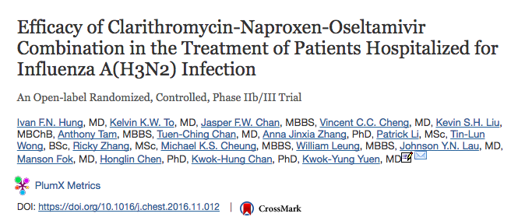

Slide 8
DESIGN and Methods
Single-center, open-label randomized control trial at a tertiary care center(Queen Mary Hospital, Hong Kong)
Enrollment February 2015- April 2015
Of 334 screened, 217 patients met inclusion criteria
Combination Group = 107 patients
Monotherapy Group = 110 patients
Follow-up: 90 days

Slide 9
N= 217 patients
Control group(n=110):
oseltamavir 75 mg BID for 5 days
Combination therapy(n=107)
oseltamavir 75mg BID + clarithromycin 500 mg BID + naproxen 200 mg BID X 2 days
Followed by oseltamavir 75mg BID x 3 days
Initiation of therapy within 24-hours of admission
All patients received 5 days of oral amoxicillin-clavulanate 1 g BID for empiric treatment of acute community-acquired PNA
All patients received esomeprazole 20 mg daily for prevention of gastropathy induced by stress or a nonsteroidal antiinflammatory drug (NSAID).

Slide 10
Discussion Break
What do you think of the study design?

Slide 11
Endpoints
Primary outcome:
30-day mortality
Secondary outcomes:
90-day mortality
Serial changes in the nasopharyngeal aspirate (NPA) virus titer
Percentage change of neuraminidase-inhibitor-resistant A(H3N2) virus (NIRV) quasispecies measured by means of pyrosequencing
Pneumonia severity index (PSI) from days 1 to 4 after antiviral treatment
Length of hospitalization

Slide 12
Discussion Break
Thoughts on the chosen endpoints?

Slide 13
Population
Inclusion Criteria
Exclusion Criteria
≥ 18 years of age
auditory temperature ≥ 38°C plus one of the following symptoms:
cough, sputum production, sore throat, rhinorrhea, myalgia, headache, or fatigue on admission
symptom duration ≤ 72 hours
laboratory-confirmed A(H3N2) influenza via NPA PCR testing. (tested to rule out atypicals)
radiologic changes of pulmonary infiltrate at chest radiography or computed tomography
clinically required hospitalization
History of allergy to study medications
Creatinine clearance < 30 mL/min

Slide 14
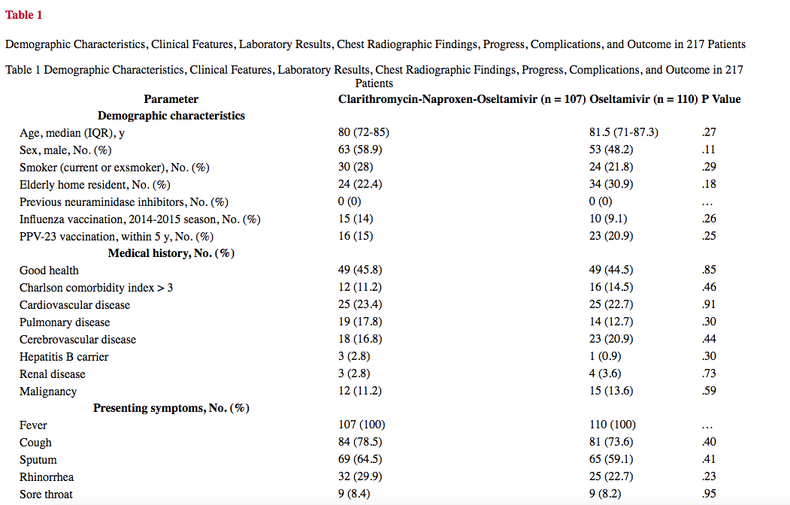

Slide 17
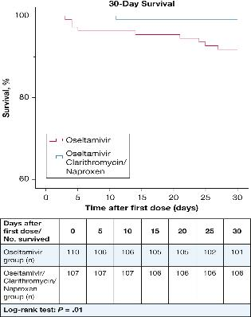
RESULTS
Combination treatment was associated with:
lower 30-day mortality (P = .01)
lower 90-day mortality (P = .01)
less frequent HDU admission after hospitalization (P = .009),
shorter acute care hospital stay (P < .0001)
*Multivariate analysis showed that combination treatment was the only independent factor associated with lower 30-day mortality (OR, 0.06; 95% CI, 0.004-0.94; P = .04).

Slide 18
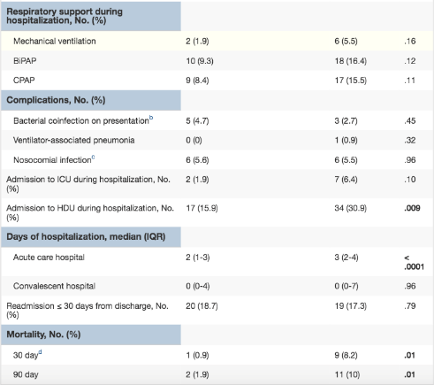
Combination therapy reduced 30-day mortality from 9/110 to 1/107 (p=0.01) and 90-day mortality from 11/110 to 2/107(p=0.01)
Combination therapy reduced admission to the intensive care unit (7/110 vs. 2/107; p=0.1) and the step-down unit (34/110 vs. 17/107; p=0.009).
The median duration of hospitalization was decreased from three days to two days in the combination therapy group (p<0.0001).
Note: patients in the monotherapy group had higher(3-fold) rates of mechanical ventilation, higher uses of BIPAP and CPAP, which was not the case on admission.
*Of the patients who died:
1 patient in the combination group died of CHF
9 patients in the control group died
3 COPD exacerbation
3 CHF
3 Severe pneumonia

Slide 19
Figure 3
Profile of virus titer after treatment. Error bars represent SEM. Significant P <.05 shown in bold
Figure 4
Profile of pneumonia severity index after treatment. Error bars represent SEM. Significant P <.05 shown in bold. PSI = pneumonia severity index

Slide 20
Reduction in viral resistance noted statistically significant in the first 1-2 days.
However number of samples dropped after a few days due to patients refusing to have NPA samples taken once they became asymptomatic
FIGURE 5
Percentage of patients with ≥ 5% NIRV quasispecies detected. Significant P <.05 shown in bold. NIRV = neuraminidase-inhibitor-resistant A(H3N2) virus.

Slide 21
SAFETY
The combination treatment was limited to 2 days to minimize the potential side effects associated with NSAIDs and macrolides. Systematic review results demonstrated that even short-term use of NSAIDs for 72 hours can impair renal function and cause bleeding peptic ulcers, which was minimized in our study by concurrent treatment with esomeprazole.
2 patients in the combination therapy group with baseline creatinine of 1.2 mg/dL developed a rise to 1.4-1.5 mg/dL after completing treatment. This spontaneously decreased back to their baseline value.
No patients developed gastrointestinal side effects during the study period.

Slide 22
TAKE HOME POINTS
Currently oseltamivir monotherapy for is the standard therapy for patients hospitalized for influenza. However therapy has limited efficacy, a limited treatment window and susceptibility to resistance
This study demonstrated a 30-day and 90-day all-cause mortality benefit and decrease hospital length of stay with 5-day combination therapy with clarithromycin-naproxen-oseltamivir compared to monotherapy in elderly patients hospitalized for influenza with a relatively good safety profile given its short(2-day) duration
Combination therapy appears to demonstrate most benefit in reducing viral titer and resistance in the first 24 hours of therapy, though clinical significance is unclear
This study sought to represent a sicker cohort of patients(elderly, radiographic evidence of pulmonary infiltrate); however generalizability to the broader population is yet to be determined
Further evidence is needed; however for now a brief course of naproxen and clarithromycin may be considered for carefully selected patients (e.g., onset<72 hours before presentation, patients admitted to the hospital with lab-proven influenza pneumonia, adequate renal function)

Slide 23
Criticisms?

Slide 24
Criticisms/Study limitations
Inclusion criteria relatively narrow (onset<72 hours before presentation, patients admitted to the hospital with lab-proven influenza pneumonia, adequate renal function). May be difficult to generalize, especially in our patient population with multiple comorbidities
Single-center, open-label design. This limits the ability of this study to be definitive. However, the most important outcomes (mortality, viral analysis, Port Severity Index) seem fairly objective.
Generalization to other influenza strains? This study investigated the H3N2 strain of influenza, which is the dominant strain during this influenza season in the United States (figure above). So this study is ideal for now. However, it remains unproven whether these medications might work against different influenza strains in the future. This is an implicit weakness of most influenza research, because every few years we are facing a slightly different virus.
Could not entirely exclude the added antibacterial benefits of beta-lactam treatment; combined with a macrolide, it might have minimized the effect that bacterial coinfection has on virus replication.
Patients enrolled in the combination group presented 1 day later than did those in the monotherapy group, which might have put this group at some disadvantage
Enrolled only patients who presented within 72 hours from symptom onset, so the validity and generalizability of this study need to be tested further in larger studies that include immunocompromised hosts and late presenters.
In this study, patients refused to provide nasopharyngeal samples once they became asymptomatic, hence the rapid decrease in the number of samples after the first day.
Were patients of the monotherapy group more ill to begin with, or was it an effect of not receiving the combination treatment? Example: increase in need for mechanical ventilation, BIPAP, and CPAP in the monotherapy group compared to combination therapy

Slide 25
Bottom line
This single-center randomized control trial of elderly patients who were hospitalized for influenza A(H3N2) demonstrated that combination therapy with clarithromycin-naproxen-oseltamivir was relatively safe and lowered 30-day, 90-day mortality and hospitalization length of stay compared to oseltamivir monotherapy

Slide 26
DIscussion
Do you think we should start to use combination therapy for influenza patients?
Downside/benefits?
Are these results applicable to our patient population?

Slide 27
REFERENCES
Hung IFN et al. ”Efficacy of clarithromycin-naproxen-oseltamivir combination in the treatment of patients hospitalized for influenza A(H3N2) infection: An open-label randomized, controlled, phase IIb/III trial.” Chest 2017 May; 151:1069.
https://emcrit.org/pulmcrit/influenza_naproxen_clarithromycin/

