Slide 1
Prevalence of Pulmonary Embolism among Patients Hospitalized for Syncope
Prandoni et al
NEJM 375;16 October 20, 2016
Noah Duncan, MD PGY-2
Morning Report Journal Club
Tuesday June 6, 2017

Slide 2
Background
Pulmonary Embolism is an established cause of syncope, but most current diagnostic guidelines for work-up of syncope pay little attention to PE.
In patients admitted to the hospital for syncope PE is often not considered and may be missed.

Slide 3
Study Question
What is the prevalence of PE in patients hospitalized for their first episode of syncope?

Slide 4
Study Design
Cross-sectional study designed to determine prevalence of PE in patients older than 18 admitted for first episode of syncope
Multicenter study done at 11 Italian hospitals (2 academic and 9 nonacademic)
No randomization given it is a cross-sectional study

Slide 5
Funding
Funded by research funding from the University of Padua (Italian university founded in 1222)

Slide 6
Inclusion Criteria
18 years old or older
Hospitalized for first episode of syncope

Slide 7
Exclusion Criteria
Previous episodes of syncope
Less than 18 years old
Not admitted
On anticoagulation
Pregnant

Slide 8
Patients
2584 patients presented to study centers’ ED for syncope.
1876 were discharged from the ED, and therefore excluded
717 were admitted.
157 of admitted patients were excluded
118 on anticoagulation
35 had prior syncope
4 declined to participate
560 patients included in the study.

Slide 9
Demographics
Mean age 76±14
39.8% Male
6% Obese
Does not give breakdown of comorbidities, even in the appendix

Slide 10
Are these patients similar to our patients?
Hard to say without information on comorbidities
Probably older
Less obese

Slide 11
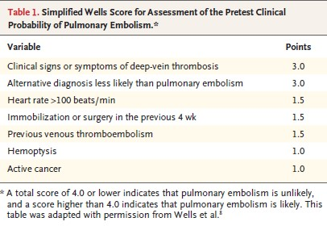
What did they do?
In all the patients included in the study they checked a D-dimer and calculated a wells score, even when there was another potential etiology for syncope.

Slide 12
What else did they do?
If D-dimer negative and wells score was less than or equal to 4 PE was considered to be ruled out
If D-dimer positive and/or wells score was greater than 4 a CT scan or VQ scan was done to evaluate for PE
There was one patient who died before CT or VQ scan could be done and an autopsy was done
In patients with PE thrombotic burden was evaluated by a committee

Slide 13
What was the “outcome” of interest?
Presence or absence of PE.

Slide 14
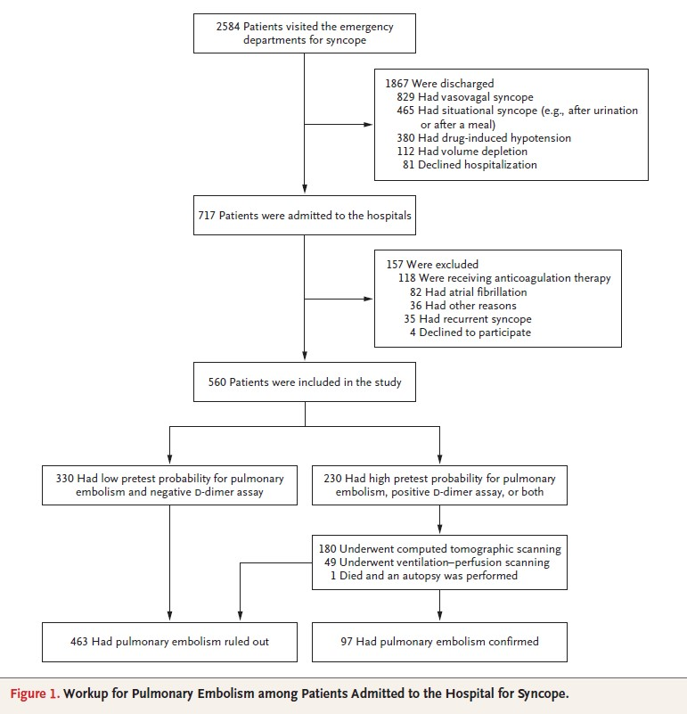

Slide 15
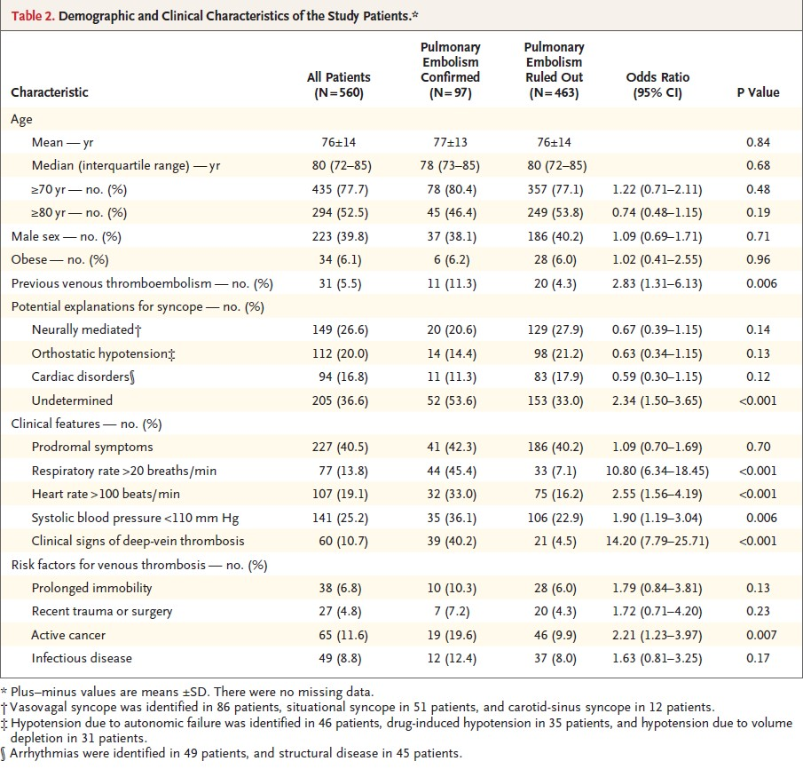

Slide 16
Results
In 330 patients PE was ruled out based on negative D-dimer and wells score less than or equal to 4.
230 evaluated for PE (135 had pos D-dimer only, 3 had well’s >4 only, 92 had both)
180 had CT scan
49 had VQ scan
1 had autopsy

Slide 17
Results – Prevalence of PE
97 patients found to have PE, prevalence of 17.3% in the entire cohort
PE found in 52 of 205 patients with no alternative etiology of syncope (25.4%, 95% CI 19.4 to 31.3)
PE found in 45 of 355 patients with an alternative etiology of syncope (12.7%, 95% CI 9.2 to 16.1)

Slide 18
Results – Extent of Thrombotic Disease
In 49 of 73 patients with a PE on CT or autopsy (67.1%) the most proximal location of PE was main pulmonary artery, right/left pulmonary artery, or lobar artery.
In 12 of 24 patients with a PE on VQ scan (50%) the perfusion defect was larger than 25% of total lung area
61 of 97 patients with PE (62.8%) had evidence of “large” PE

Slide 19
Results - Features associated with PE
Tachypnea (R>20)
Tachycardia (HR>100)
Hypotension (SBP<110)
clinical s/s of DVT
h/o VTE
Active Cancer
24 of 97 patients with PE (24.7%) had no clinical manifestations of PE

Slide 20
Follow Up
There was no follow up.

Slide 21
Limitations
No information or guidance on how PE was treated in patients where it was found.
Other work-up of syncope was not standardized. Left to discretion of physicians.
Didn’t include patients on anticoagulation or with prior history of syncope.
Didn’t include patients not admitted to the hospital.
No information on provoked VS unprovoked

Slide 22
More Limitations
Limited by its design as a cross sectional study. Naturally raises questions it’s not designed to answer.
In what percentage, if any, was PE an incidental finding?
What about the patients found to have small PEs? How should they be treated?
Outcomes?
Should we check well’s score and D-dimer in every patient admitted with syncope?

Slide 23
Take Home Message
PE is prevalent in patients admitted for syncope and should be part of your differential for a patient admitted for syncope.
In a patient admitted for the first episode of syncope a Well’s Score should be calculated and a D-dimer should at least be considered.

