Slide 1
Morning Report
John Hollowed, MD

Slide 2
Presentation
58 yo w/ h/o breast cancer s/p chemo radiation who presents w/ 2 weeks of profuse bruising over legs.
Seen in breast clinic, and sent to ER acute purpura, hemarthrosis mild intermittent headaches.
Reports that she noticed spontaneous bruising over BLE for the past week, one episode of bloody phlegm after gargling when she was brushing her teeth.

Slide 3
PMHx
  Breast Cancer: ER/PR positive, HER-2 negative. s/p lumpectomy then received Taxotere/Cytoxan for 4 cycles, then XRT, then anastrozole.
Family History:
  Cancer in her maternal aunt, maternal grandmother, and maternal uncle.
Social History:
  Never smoked. Occasional EtOH, no illicit drug use. Works as a teacher. Did not ask sexual history

Slide 4
Exam
Vitals: 38.1, 99, 100/65, 93%ra
Constitutional: She is oriented to person, place, and time. She appears well-developed and well-nourished. She appears distressed.
Head: Normocephalic and atraumatic.
Eyes: Conjunctivae are normal. Pupils are equal, round, and reactive to light. No scleral icterus.
Neck: Normal range of motion. Neck supple. No JVD present.
Cardiovascular: Normal rate, regular rhythm and normal heart sounds. Exam reveals no gallop and no friction rub.
No murmur heard.
Pulmonary/Chest: Effort normal and breath sounds normal. No respiratory distress.
Abdominal: Soft. There is no tenderness. There is no rebound and no guarding.
Musculoskeletal: Normal range of motion. She exhibits no edema or tenderness.
She has no cervical adenopathy.
Neurological: She is alert and oriented to person, place, and time. No cranial nerve deficits.
Skin: Skin is warm and dry. She is not diaphoretic. Diffuse palpable purpura, ecchymoses
Psychiatric: She has a normal mood and affect. Her behavior is normal. Judgment and thought content normal.

Slide 5
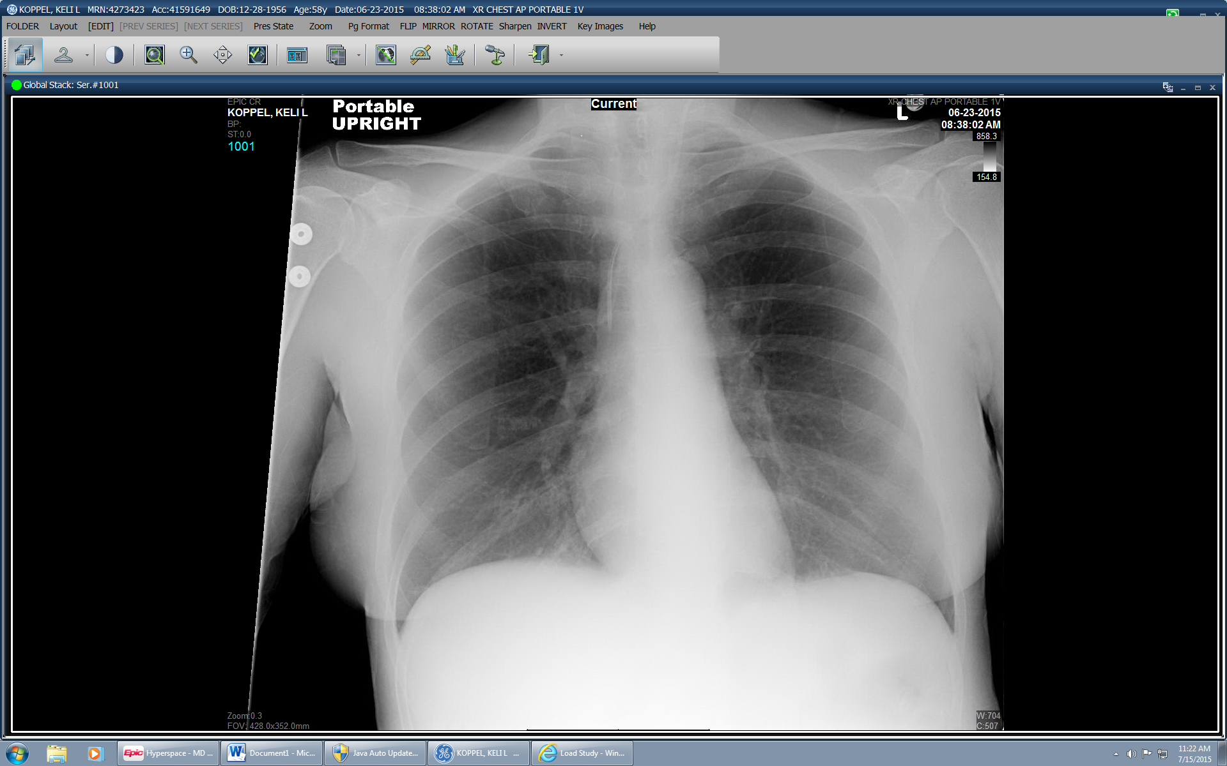

Slide 6
CBC: 12>9.3/27<15
MCV 99
RDW 50
Promyelocytes: 13% (H)
Segmented Neutrophils: 1% (L)
Lymphocytes: 28% (nl)
Monocytes 1% (L)
Blast cell 64% (HH)
PT: 13.4 (H)
INR: 1.3 (H)
aPTT: 24
Fibrinogen: 97 (L)
D-dimer: 4900 (H)
137/4.2/98/27/13/0.98<106
Ca: 9.8
LFT: wnl
Uric acid: 5.1
Blood Cx: Negative
UA: 3+ Blood

Slide 7
CXR 6/12:
  Left internal jugular central venous catheter with the tip terminating at the cavoatrial junction. No pneumothorax or pleural effusion. The lungs are clear. Current mediastinal silhouette within normal limits. Visualized osseous structures grossly normal.
CT brain 6/12:
  Acute subarachnoid bleeding, most evident along the right intraparietal sulcus.
  Additional note is made of a nonspecific tiny hyperattenuating focus along the right supraclinoid internal carotid artery likely representing a focal calcification; less likely tiny aneurysm.
CT brain 6/13:
  No significant interval change. Redemonstration of subarachnoid bleeding, most evident along the right intraparietal sulcus. Additional note is made of a nonspecific tiny hyperattenuating focus along the right supraclinoid internal carotid artery likely representing a focal calcification; less likely tiny aneurysm.

Slide 8
Path Reports
Pathology Report:
Acute promyelocytic leukemia with t(15;17)(q22;q12); PML-RARA, involving >95% of marrow cellularity. Flow cytometry demonstrates excess abnormal myeloblasts (76%) with aberrant expression of CD2 and CD7

Slide 9
Initial Stabilization and Plan:
- Tretinoin 40 mg BID
- Dex 10mg daily to prevent differentiation syndrome
- Idarubicin 12 mg/m2 q48h x 4 doses, start after echo is done
- IV fluids with regimen: D5 1/2 NS @ 100 cc/hr x 7 days
- Antinausea prophylaxis with ondansetron 12 mg IV q48 x 4 doses, 8 mg PO q8h IV prn, prochlorperazine PRN.
- For DIC: Keep platelets >100,000, fibrinogen > 150 by transfusing cryoprecipitate, check CBC, coags, fibrinogen q6h
HOSPITAL COURSE:
# High-Risk APL requiring treatment with ATRA and Idarubicin: Day 27 (7/9)
- Regimen: Tretinoin 40mg BID (6/13- ), s/p Idarubicin 12 mg/m2 q48h x 4 doses (6/15, 6/17, 6/19, 6/21)
- Dex 10mg daily to prevent differentiation syndrome--slowly wean to 8mg iv daily--> 6mg iv daily (6/21) -> 4mg (6/23)- > 2mg (6/28)-> 1mg (7/2) -> 1mg QOD (7/7) for one more week.
# Febrile Neutropenia with Urine VRE and subsequent urine culture with no growth (7/2)
- Blood Cx NTD (7/2)
- IJ CVC removed (7/1), will place a PAC or PICC line later on
- s/p Caspofungin (7/1-7/7 )
- Antibiotics: Meropenem -> Levaquin, Linezolid (6/28- ) for urine cx + VRE

Slide 10
Acute Promyelocytic Anemia
A Brief History
First identified as a rare variant of leukemia in 1958.
Researchers and clinicians noticed a distinct quality where myeloid lineage cells not only divided at rapid and uncontrolled rates, but were also frozen in immature development.
Promyelocytes would not progress in development and began to release toxic enzymes (normally designed to fight infection) precipitating massive bleeding and sepsis.

Slide 11
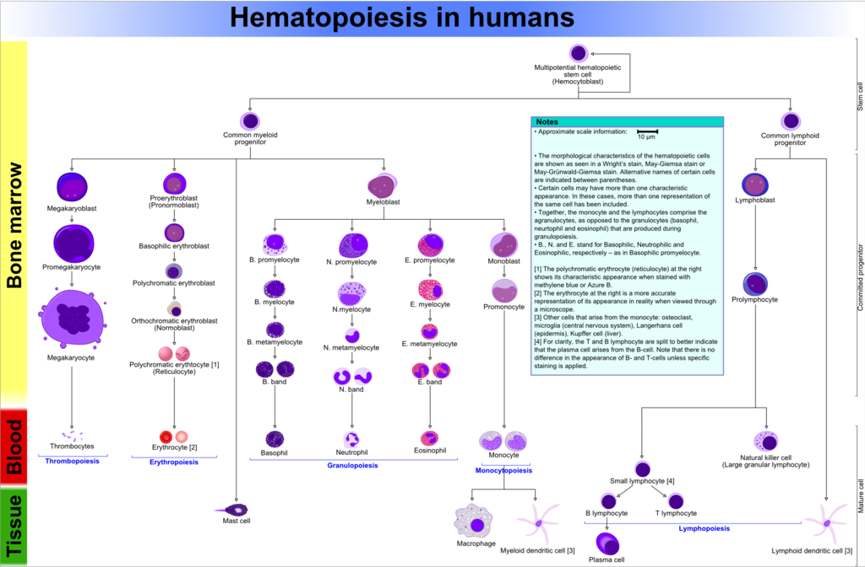

Slide 12
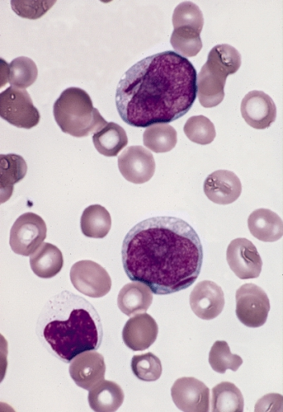
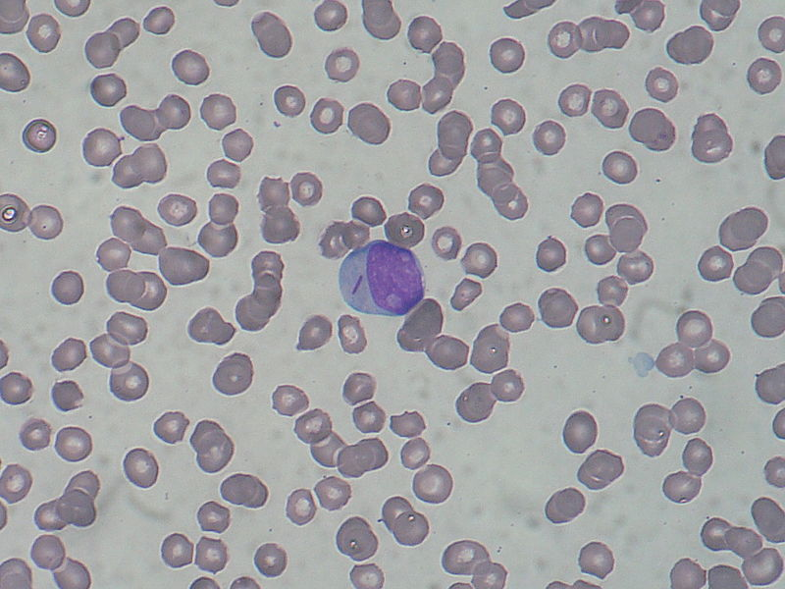
Peripheral Smear Characteristics
Myeloblasts with Auer Rods

Slide 13
History Continued
This frozen state prompted enticed targeted drug therapy research with numerous chemicals, finally honing in on Vitamin A (retinoic acid), which would induce maturation in small percentages of cell lines.
In the 1980s two research teams, one in China and the other in Italy, were not and chose to examine retinoic acid further testing its two forms, cis-retinoic acid and trans-retinoic acid.

Slide 14
Miraculously, they found that the trans-form of retinoic acid specifically induced maturation
Unexpectedly, not only did the cells mature, but the immature cell lines in the bone marrow died off and patients experienced remission for months -> years
When combinations of chemotherapeutic agents were combined these teams found that 75% of their patients would never relapse, something unheard of in cancer therapy.

Slide 15
Epidemiology
APL accounts for 5-20% of AML cases
Accounts for 600-800 new cases per year in the United States
Uncommon in 1st decade of life, with incidence increasing in second and third decade and reducing in 60s.
Increased incidence in people with prior cytotoxic therapy especially topoisomerase-II inhibitors such as etoposide and doxorubicin.

Slide 16
Molecular Biology
The leukemic cells of 92% of patients with APL have the balanced translocation t(15;17) involving the RARa gene on chromosome 17 and the ProMyelocytic Leukemia (PML) gene on chromosome 15
The PML/RARa protein functions as an aberrant retinoid receptor, expression of which blocks retinoic acid-induced myeloid differentiation
Diagnosis is made with Bone Marrow Aspirate analysis and confirmation with PCR, FISH, or cytogenic analysis of peripheral blood or bone marrow showing classic translocation

Slide 17
Clinical Features
Symptoms related to complications of pancytopenia (ie, anemia, neutropenia, and thrombocytopenia), including weakness and easy fatigability, infections and/or hemorrhagic findings such as gingival bleeding, ecchymoses, epistaxis, or menorrhagia
(DIC) is frequently present at diagnosis or after initiation of cytotoxic chemotherapy. This is a medical emergency as pulmonary or cerebrovascular hemorrhage can occur in up to 40% of patients and there is a 10-20% risk of hemorrhagic death

Slide 18
Prognosis and Treatment
Risk:
  Low risk – WBC ≤10 x 10⁹/L and platelets >40 x 10⁹/L; Relapse free survival (RFS) 98%
  Intermediate – WBC ≤10 x 10⁹/L and platelets ≤40 x 10⁹/L; RFS 89%
  High risk – WBC >10 x 10⁹/L; RFS 70%
Treatment:
  ATRA plus Aresenic trioxide (ATO) for APL patients with low -> intermediate risk
  ATRA plus anthracycline-based chemo regimen in patients in high risk group

Slide 19
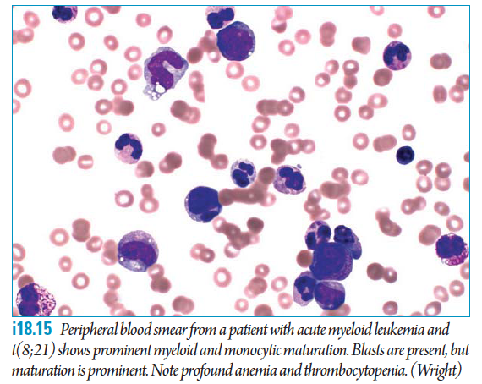
What do we NEED to know
Be able to identify blasts on CBC diff and peripheral smear
Page Heme-Onc service if you have suspicion
Initiate ATRA early
Treat DIC

