Slide 1
Morning Report
Liza Buchbinder
UCLA Oliveview
May 9, 2017

Slide 2
Chief Complaint
45 year old male with gradual physical and cognitive decline over past 6 months.

Slide 3
HPI
45 year old male sent from OVMC ED for “medical clearance” from psych ED.
Pt on 5150 for GD
Patient unable to cooperate in HPI. All information from SW.
Over past 6 months, patient’s ability to perform ADLs and IADLs has declined, including walking, speaking, continence, comprehension and cognition.
Declines housing assistance. Lives in expensive hotel.
Stopped eating regularly or grooming.
Frequent falls and impaired gait.

Slide 4
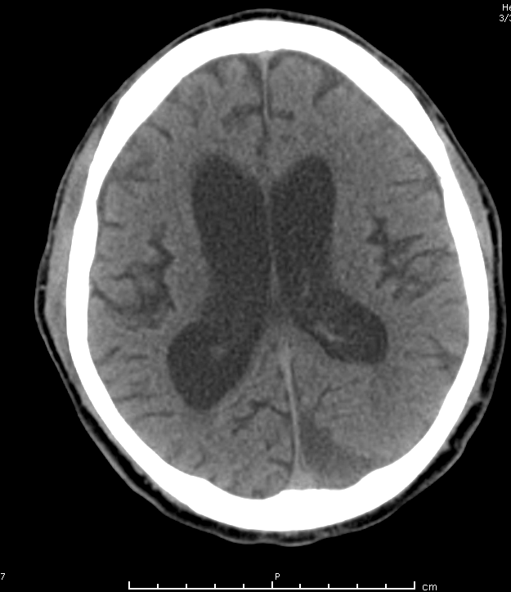

Slide 5
CT Brain
No acute bleed.
Stable subdural hematomas bilateral prefrontal 5 mm (left) and 4 mm (right).
Stable late subacute/chronic subdural hematoma left occiput 20 mm.
Stable significant cerebral atrophy and caudate head atrophy consistent with Huntington's.
Stable enlarged lateral, third ventricles, cerebral aqueduct and fourth ventricle.

Slide 6
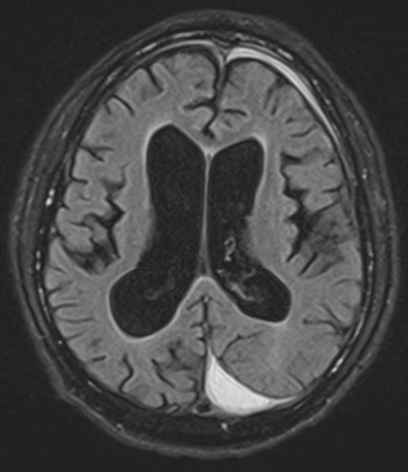
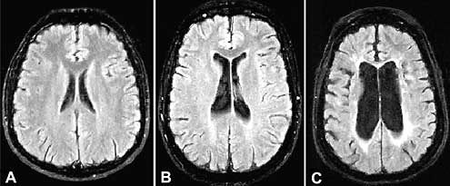

Slide 7
MRI Brain
No gross acute intracranial pathology.
Partially loculated chronic subdural hematomas, largest in the region of the left occipital pole, possibly of varying ages.
There is bilateral caudate and putamen atrophy consistent with the history of Huntington's disease.
Generalized atrophy including brainstem atrophy raises the possibility of other neurodegenrative diseases.
Enlargement of the ventricles with prominent lateral and third ventricles. Ventricular enlargement is out of proportion to the prominent cerebral sulci. The constellation of findings suggests probable ex vacuo dilatation with possible superimposed communicating hydrocephalus associated with TBIs.

Slide 8
Hyperkinetic Movement Disorders
Essential Tremor
Dystonia
Huntington’s Chorea
Restless Leg Syndrome/Sleep Related Movement Disorders
Tics and Tourette’s
Drug Inducted (Tardive Dyskinesia/NMS)

Slide 9
Movement Disorders
Hypokinetic (e.g. Parkinson’s) and Hyperkinetic
On physical exam: gait, motor fxn, speed, amplitude, consistency, fatigability
Tone (e.g. hypokinetic – rigidity)
Gait – wide based? Pace? Stride length? Arm swing? Stability?
Pull Test
Cognitive evaluation

Slide 10
Huntington’s
Chorea = random, non-repetitive flowing dancelike movements
Etiology: Autosomal dominant; Drug induced (antipsychotics, estrogen containing); Endocrine (thyrotoxicosis, hyperglycemia); pregnancy (chorea gravidarum); streptococcal infection (Sydenham chorea); autoimmune (SLE, APLS); neurodegenerative d/o of basal ganglia.
Most common neurodegenerative cause of generalized chorea
Associated w/ parkinsonism, impulsiveness, psychiatric disorders, and dementia.
Expression from the length of a repeat section (trinucleotide repeat CAG) on chromosome 4 (i.e. the huntingtin gene)
<26 repeats = normal
27 to 35 repeats = intermediate allele or normal allele w/ potential meitotic instability
36 to 39 repeats = HD allele with reduced penetrance
>39 repeats = HD allele w/ full penetrance
Treatment is symptomatic

Slide 11
Essential Tremor
Essential tremor: bilateral upper extremity postural and action tremor. Improves with alcohol, onset late adolescent or middle age, slow progression. 50% + family history. Only small percentage have progressive worsening over time.
Essential (or action) tremor should be distinguished from enhanced physiologic tremor.
Physiologic tremor enhanced by triggers, such as medications, caffeine, toxins, thyroid disease, exertion, or anxiety, it can appear similar to essential tremor.
Patients younger than 40 years should undergo testing for Wilson disease with serum ceruloplasmin and 24-hour urine copper measurements and with slit lamp examination for Kayser-Fleischer rings. Atypical causes of action tremor include dystonic tremor, rubral tremor, and fragile X tremor ataxia syndrome.
TREATMENT - Symptomatic
First line: propranolol and primidone.
Second line (adjuvants): clonazepam, topiramate, gabapentin, and nimodipine, may provide additional tremor control in some patients.
Botox for refractory tremor, especially those with prominent neck or voice tremor.
DBS of the thalamus (specifically, the ventral intermediate nucleus) for refractory disease.

Slide 12
Resting Tremorª
Parkinsonian resting tremor | Parkinson disease | Re-emergence of tremor after a short delay with outstretched posturing and during ambulation, associated with other parkinsonian signs (rigidity, bradykinesia, gait impairment)
 | Atypical, drug-induced, and vascular parkinsonism | Similar to Parkinson disease; tremor sometimes symmetric; red flags for atypical parkinsonism sometimes present
Dystonic tremor | Dystonia | Associated with dystonic posturing; seen both at rest and with action; position dependent with a null point at which tremor stops
Action Tremor
Postural and kinetic tremors^{b} | Essential tremor | Present in the outstretched arm position and with various actions; commonly (but not universally) associated with a positive family history and an improvement in symptoms with alcohol
 | Enhanced physiologic tremor | Normal low-amplitude, high-frequency tremor seen in association with triggers, such as stress, drugs, and thyroid disease; similar to essential tremor but resolves with resolution of underlying physiologic stressor
Intention tremor^{c} | Cerebellar disease | Tremor during movements that increases in amplitude as hand approaches target (also known as terminal tremor); possible association with other cerebellar symptoms, including dysmetria
 | Fragile X tremor ataxia syndrome | Neurodegenerative disease seen in older men with a family history of mental retardation in young males and premature ovarian failure in females; symptoms of (intention) tremor, ataxia, parkinsonism, neuropathy, and dementia
Rubral tremor | Cerebellar outflow disorders (multiple sclerosis, stroke, traumatic brain injury) | Coarse proximal tremor present at rest, worse with posturing (especially large-amplitude and proximal tremors in the “wing-beating” position with elbows flexed), and most severe during movements.
Task-specific tremor | Primary writing tremor | Only present with specific task
Orthostatic tremor | Orthostatic tremor | High-frequency tremor emerging in the legs only during standing (orthostatic position); resolving with sitting or action

Slide 13
Dystonia
Sustained, stereotyped, and directional twisting and posturing movements of various body parts.
Generalized dystonias involve multiple body parts, including the lower extremities, whereas focal and segmental dystonias have a restricted distribution and usually spare the lower extremities.
Generalized dystonias: age of onset <25 years.
Etiology: metabolic and genetic disorders; ischemic and infectious damage to the basal ganglia; Wilson’s disease.
All patients with primary generalized dystonia should be challenged by a short trial with low-dose levodopa to screen for dopa-responsive dystonia, a rare but treatable cause of generalized dystonia.
The most common type of generalized dystonia is associated with mutation in the dystonia 1 gene (DYT1).
Focal dystonias: cervical dystonia (spasmodic torticollis), eyelid dystonia (blepharospasm), vocal cord spasmodic dysphonia, and task-specific hand dystonia (writer's cramp and musician's dystonia).
Transient improvement of dystonic movement by a sensory trick (“geste antagoniste”), such as specific sensory stimuli (gently touching the involved area with the hand), provides further diagnostic clues.
Rx: anticholinergic agents, benzodiazepines, and baclofen.
Rx: For focal dystonias, including torticollis, botox injections.
Rx: For primary generalized dystonia, DBS of the globus pallidus interna can markedly improve dystonia. (Especially pts w/ positive DYT1 mutation show best response to DBS.)

Slide 14
Tics and Tourette’s
Tics are stereotyped, brief, rapid movements that break the flow of normal movements.
Partially suppressible, tics also provide transient relief from uncomfortable focal sensations (premonitory urges).
Most patients achieve full remission or significant reduction of tics by adulthood.
Tourette syndrome is characterized by childhood onset, persistence of multiple complex motor tics for at least 1 year, and presence of vocal tics.
Echolalia (repetition of others' words) and coprolalia (utterance of obscenities) are rare but classic forms of complex vocal tics.
Pathophysiology: Possibly genetic influences causing disruption of the basal ganglia–frontal cortex network. Associated with: OCD, ADHS, and mood disorders.
Treatment: reassurance (often appropriate in mild disease), cognitive behavioral therapy, and treatment of psychiatric comorbidities.
Only the antipsychotic agents pimozide and haloperidol are FDA approved
α₂-adrenergic agonists clonidine and guanfacine; benzodiazepines; the dopamine-depleting agent tetrabenazine; topiramate; and—in patients with refractory disease—the antipsychotic agents aripiprazole, ziprasidone, and risperidone are also used.
Botulinum toxin may provide an additional option for certain simple (blinking) or potentially dangerous (cervical whiplashing) tics.

Slide 15
Restless Leg
Restless Leg
Uncomfortable sensations in the legs at rest or when falling asleep, an urge to move the legs, and immediate relief after moving the legs or walking.
Patients with RLS should be screened for iron deficiency and receive iron supplements in the presence of deficiency or even low-normal serum ferritin levels (<45 ng/mL [45 µg/L]).
SSRIs and dopamine-blocking agents can worsen RLS. Stimulants should be avoided late in the day.
Rx: dopamine agonists (e.g. pramipexole, ropinirole, and the rotigotine patch).
Side effects of impulse control disorder limit their use. Can also development augmentation (symptoms begin to appear earlier in the day) and rebound (symptoms return with greater intensity as the dose wears off) with these meds.
Other options: levodopa, gabapentin, opioids, benzodiazepines, and carbamazepine.
Periodic limb movements of sleep
Brief triple flexion movements of the lower legs that repeat several times in 20-second cycles during early sleep. Only treat if disrupts sleep.
REM sleep behavior disorder
Patients do not have normal muscle paralysis during the REM phase of sleep and, as a result, tend to physically act out their dreams; this tendency leads to shouting, kicking, punching, and similar behaviors during sleep. Effective Rx: clonazepam and melatonin.
In recent years, REM sleep behavior disorder has been identified as a strong predictor of future development of Parkinson disease and other related disorders, such as multiple system atrophy and dementia with Lewy bodies.

Slide 16
Tourette’s
Dystonia

Slide 17
Tardive Dyskinesia
Huntington’s Chorea

Slide 18
Intention Tremor

