Slide 1
PRESENTER: Quynh vu, pgy-2
Ucla-olive view internal medicine
c/o VASIF MAYAN

Slide 2
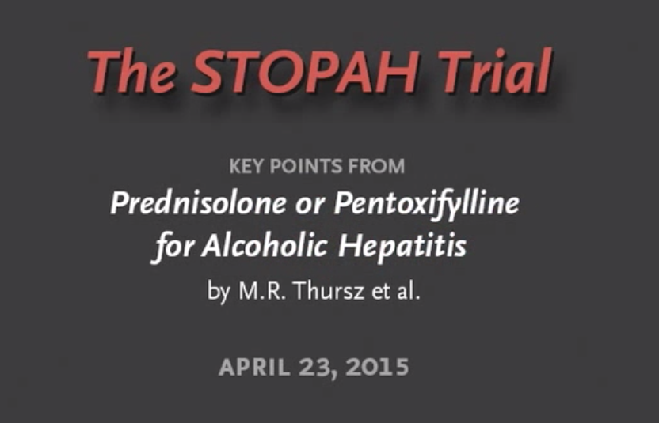
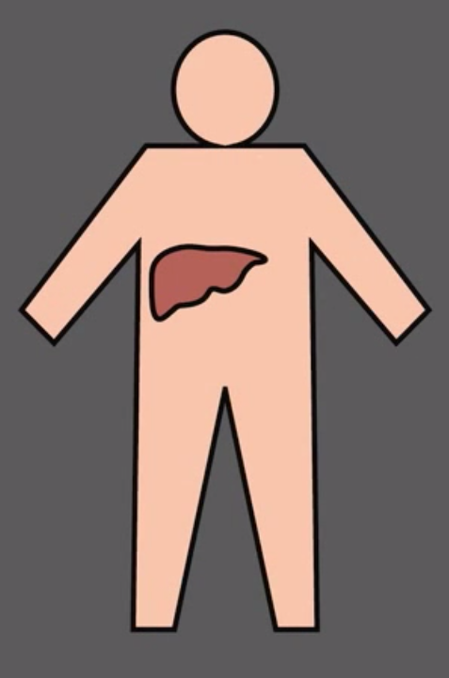

Slide 3
NEW ENGLAND JOURNAL OF MEDICINE, APRIL, 2015
STeroids Or Pentoxifylline for Alcoholic Hepatitis
to determine whether prednisolone or pentoxifylline administered for a 28-day period reduced short-term and medium-term mortality among patients admitted with severe alcoholic hepatitis

Slide 4
BACKGROUND
Alcoholic hepatitis is a distinct manifestation of alcoholic liver disease that is characterized by jaundice and liver failure in a patient with history of prolonged and heavy alcohol use.
The severity of alcoholic hepatitis is conventionally defined by Maddrey’s discriminant function
[4.6 × (difference in PT) + serum bilirubin level ( mg/dl)]
>32 indicates severe alcoholic hepatitis that carries an adverse prognosis
20 to 30% mortality within 1 month after presentation
30 to 40% mortality within 6 months after presentation

Slide 5
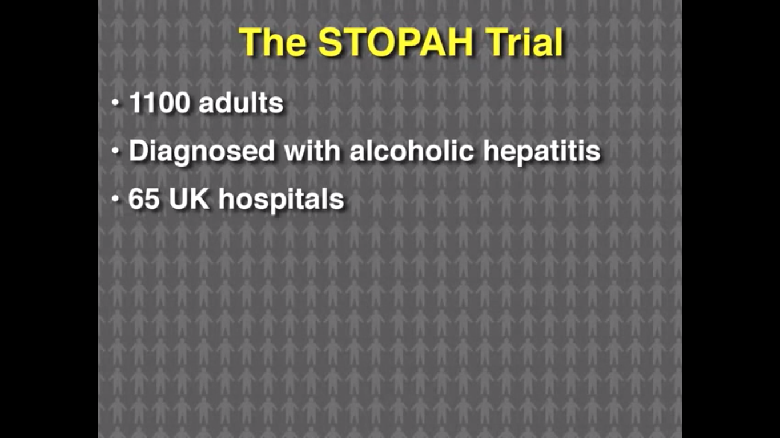
METHODS
Study Design and Oversight
Multicenter
Randomized
double-blind trial

Slide 6
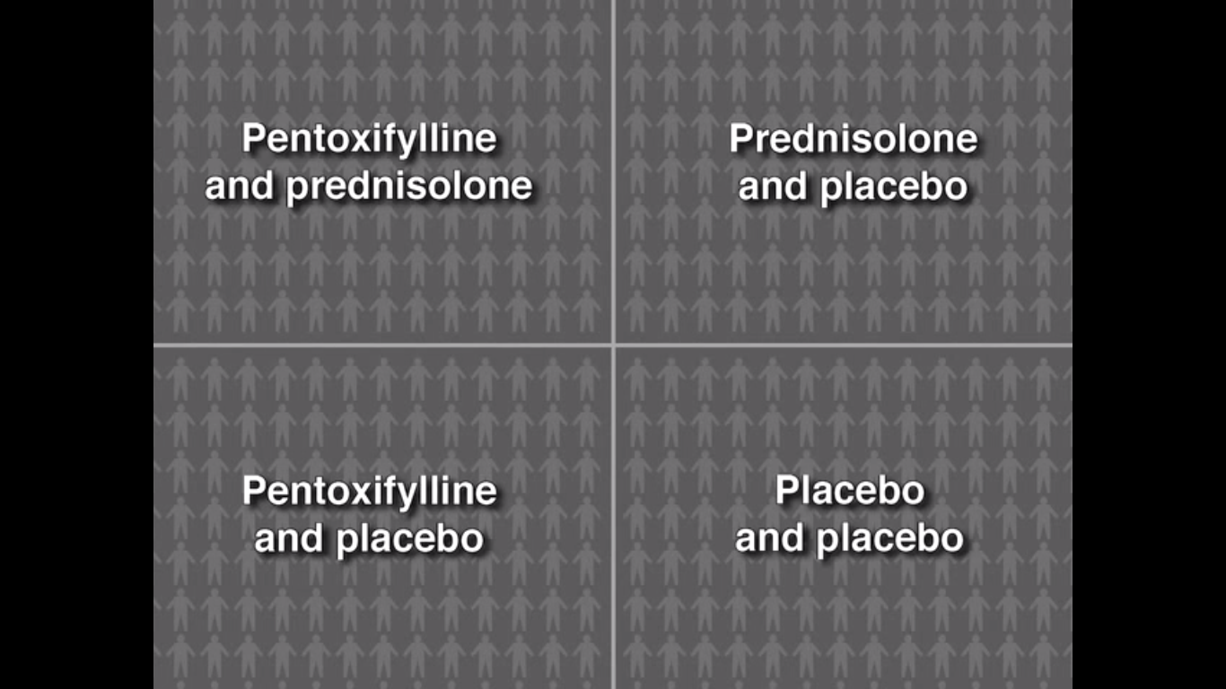

Slide 7
INCLUSION CRITERIA
18 years or older
clinical diagnosis of alcoholic hepatitis
average alcohol consumption of more than 80 g per day for men and more than 60 g per day for women,
Serum bilirubin level >80 μmol/L (4.7 mg/dL)
Discriminant function of 32 or higher

Slide 8
EXCLUSION CRITERIA
Cessation of alcohol consumption for more than 2 months before randomization
Duration of jaundice > 3 months
Serum AST>500 or ALT>300
Other causes of liver disease including:
  Evidence of chronic viral hepatitis (Hepatitis B or C)
  Biliary obstruction
  Hepatocellular carcinoma

Slide 9
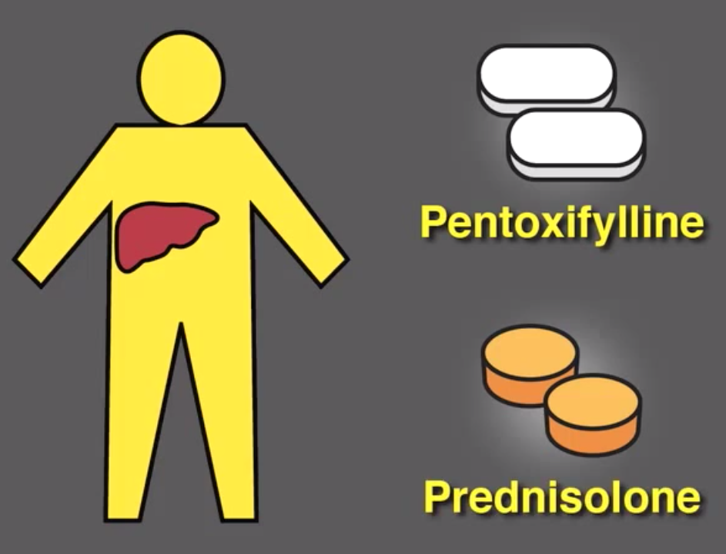
TREATMENT PROTOCOL
prednisolone 40mg qday x 28 days
pentoxifylline 400mg tid x 28 days

Slide 10
CRITIQUE BREAK
Clinically sensible intervention?
Any “contamination” of controls?
Any “co-interventions” for the treated?

Slide 11
END POINTS
Primary end point: all-cause mortality at 28 days
Secondary end points: all-cause mortality or liver transplantation at 90 days and at 1 year

Slide 12
Evaluations During and After Treatment
Treatment Day 7, 14, 21, and 28
On discharge from hospital
3 months
1 year

Slide 13
INDICATORS USED
Maddrey’s discriminant function
MELD score
Glasgow alcoholic hepatitis score
Lille score

Slide 14
CRITIQUE BREAK
Blinded results?
Would you have chosen the same outcomes?

Slide 16
28-DAY MORTALITY
GROUP | MORTALITY
PLACEBO PLACEBO | 17
PREDNISOLONE PLACEBO | 14
PENTOXIFYLLINE PLACEBO | 19
PREDNSIOLONE PENTOXIFYLLINE | 13

Slide 17
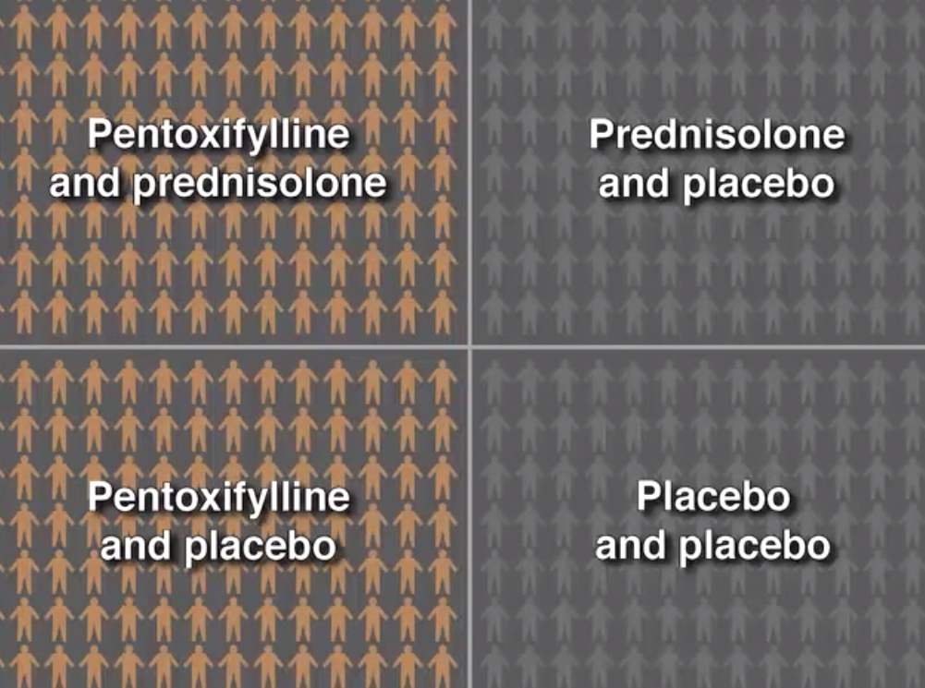
Pentoxifylline

Slide 18
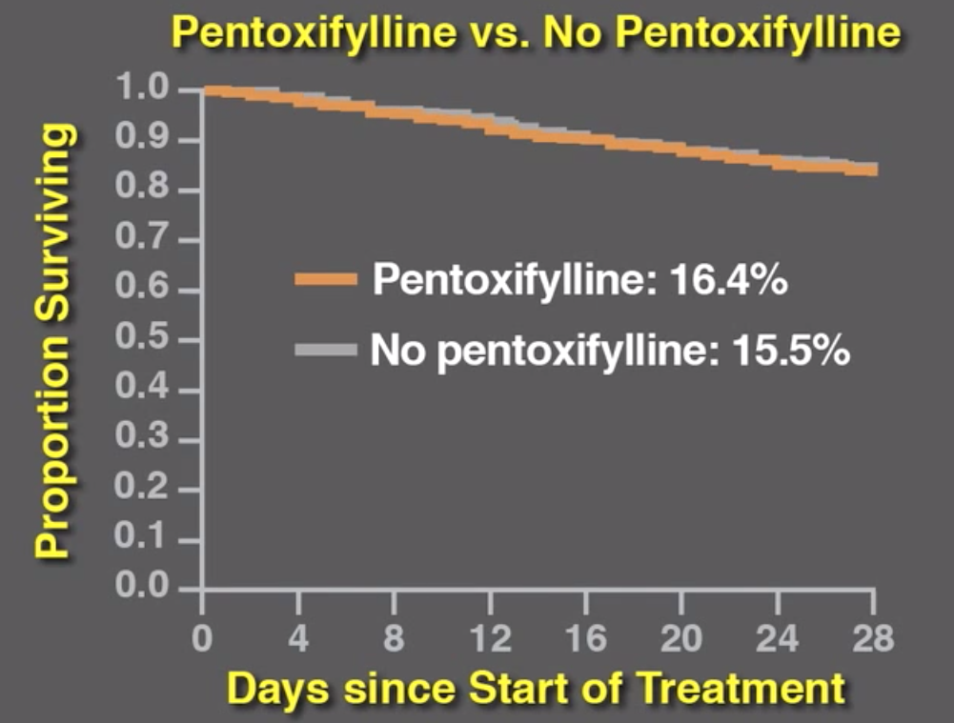

Slide 19
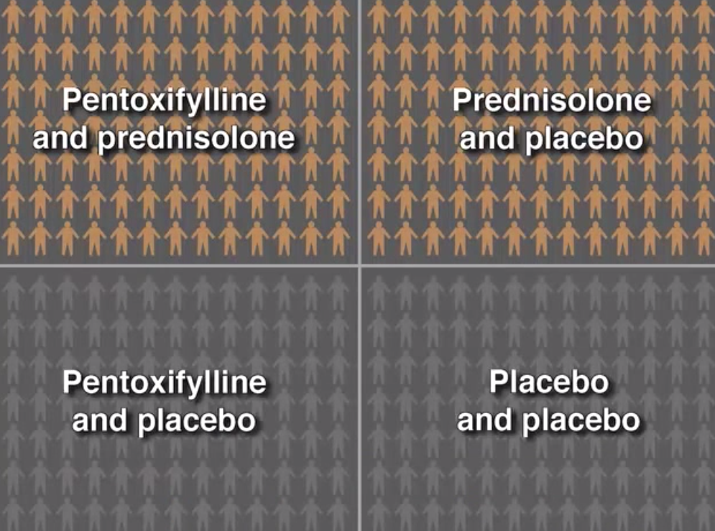
Prednisolone

Slide 20
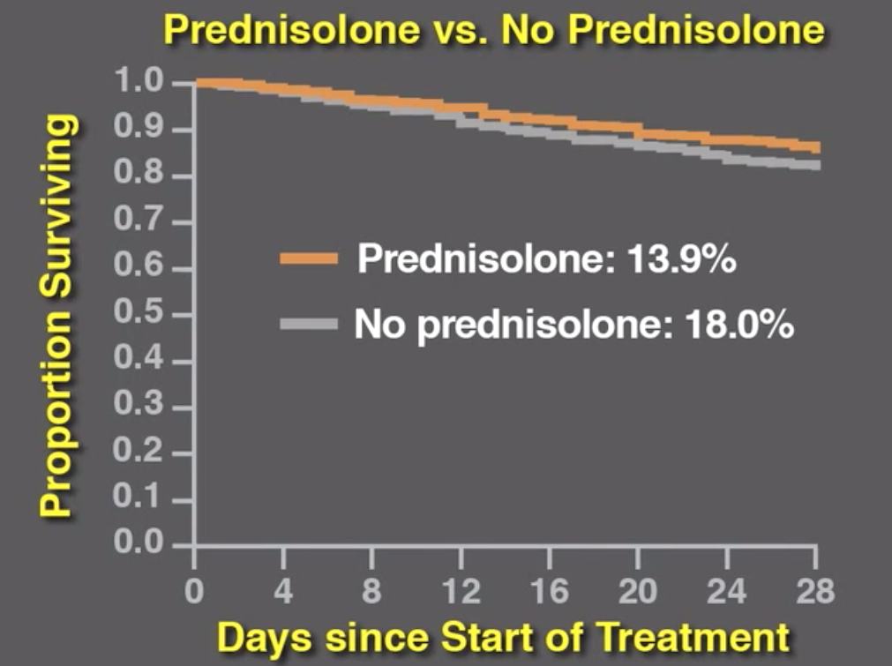
P value 0.06

Slide 21
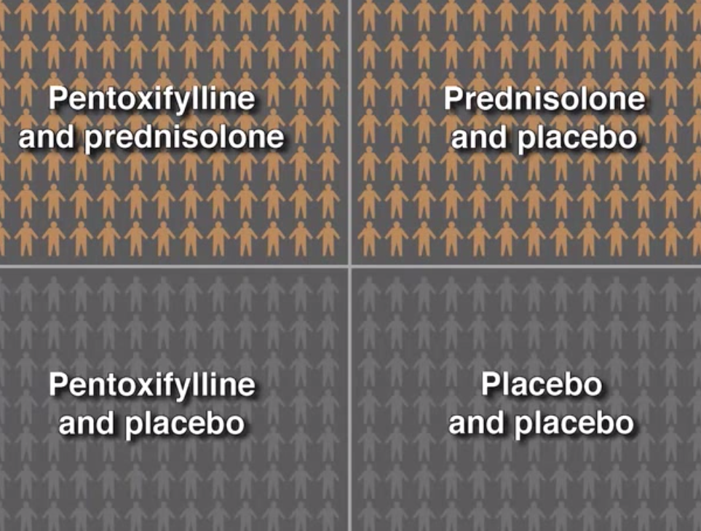
Infections were nearly twice as common in the prednisolone group

Slide 22
ADVERSE EFFECTS
Prednisolone group infection rate 13%
Groups without prednisolone 7%
[ p value 0.002]
95% deaths during the study were due to liver related causes
24% were due to infections

Slide 23
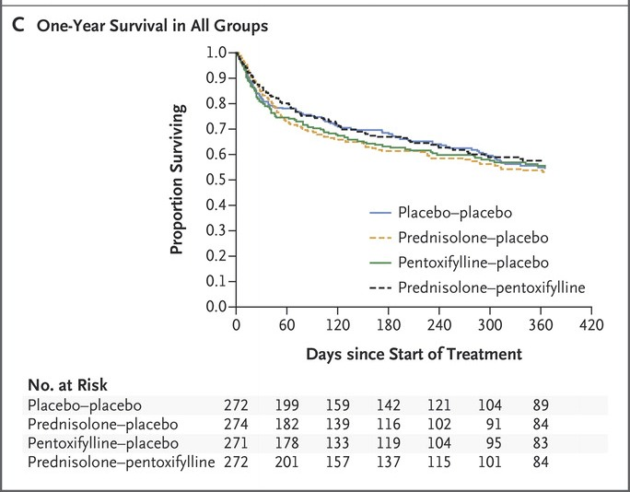

Slide 24
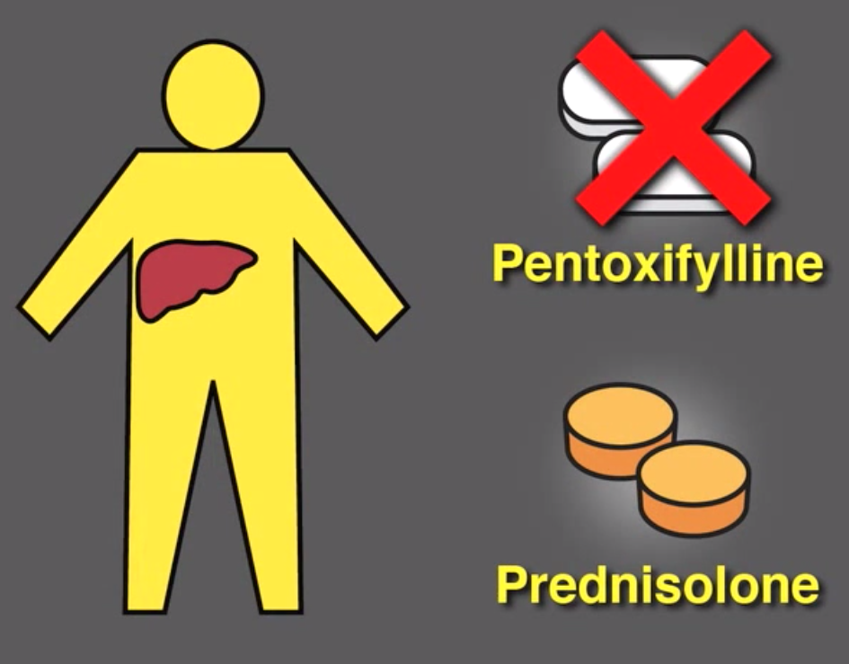
No clear mortality benefit for Pentoxifylline

Slide 25
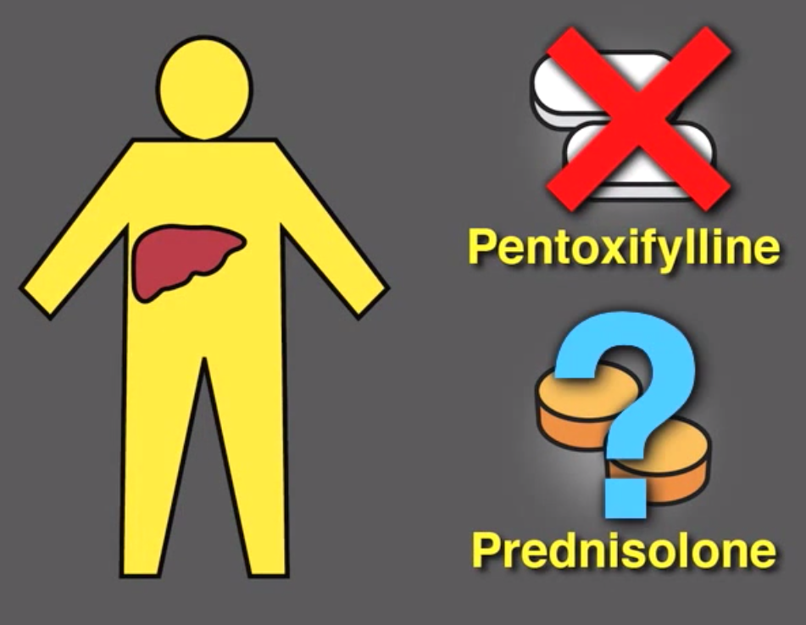
Uncertainity persists regarding Prednisolone

Slide 26
DISCUSSION
Controversy over the use of glucocorticoids in severe alcoholic hepatitis has persisted for many years
In the study, the reduction in 28-day mortality observed among patients treated with prednisolone did not reach the conventional threshold of statistical significance
No significant differences were observed in 90-day or 12-month outcomes
Significant advantage with respect to 28-day mortality was seen with prednisolone

Slide 27
In summary, in the STOPAH trial, pentoxifylline did not improve outcomes in patients with alcoholic hepatitis
The findings suggest that the administration of 40 mg of prednisolone daily for 1 month may have a beneficial effect on short term mortality but not on the medium-term or long-term outcome of alcoholic hepatitis

