Slide 1
Coronary artery disease

Slide 2
CASE #1
60 y/o woman h/o DM, HTN, current smoker who presents with 3 months of intermittent chest pain. The pain is pressure-like, substernal without radiation and usually lasts for about 3-5 minutes. Symptoms come and go without warning. The patient is unable to identify exacerbating or relieving factors. Initial Trop and EKG wnl.

Slide 3
Pretest probability of CAD

Slide 4
Risk stratification
HEART SCORE
History, ECG, Age, Risk factors and Troponin
2,440 unselected patients presented with chest pain at the ED of 10 hospitals in The Netherlands. HEART score was assessed as soon as the first lab results and ECG were obtained. Primary endpoint was the occurrence of major adverse cardiac events (MACE) within 6 weeks.
Results
Low HEART scores (0–3) MACE 1.7%.
Intermediate HEART (4–6) MACE 16.6%.
High HEART scores (7–10), MACE 50.1%
Notes:
doi: 10.1016/j.ijcard.2013.01.255

Slide 5
Chest Pain
Pretest Probability of CAD
Low
Intermediate
High
Normal EKG? Able to Exercise?
ETT
Exercise Stress Test with Imaging
Pharmacologic Stress Test
LHC
Medical Therapy

Slide 6
CASE #2
66 y/o M with DM, HTN who presents with 4 hours of substernal chest pain, radiating to the jaw associated with shortness of breath. The pain started earlier in the morning when the patient was working in his garden. He has never had these symptoms before. Symptoms improved with SL NTG given in the ED. EKG and Trop were negative.
Notes:
TIMI score

Slide 7
CASE #3
59 y/o M h/o CAD, HTN, who presents with exertional SOB and chest tightness. The patient was our walking his dog earlier in the evening and after 2 blocks suddenly developed chest tightness that resolved after 10 minutes of rest. The patient had another episode of chest tightness on the way home. In the past few months, the patient has been able to walk 5-6 blocks without any issues. In the ED, EKG and trop were negative.
Notes:
TIMI score

Slide 8
Clinical features
Notes:
doi:10.1001/jama.280.14.1256

Slide 9
CP Ddx -->
Notes:
doi:10.1001/jama.280.14.1256

Slide 10
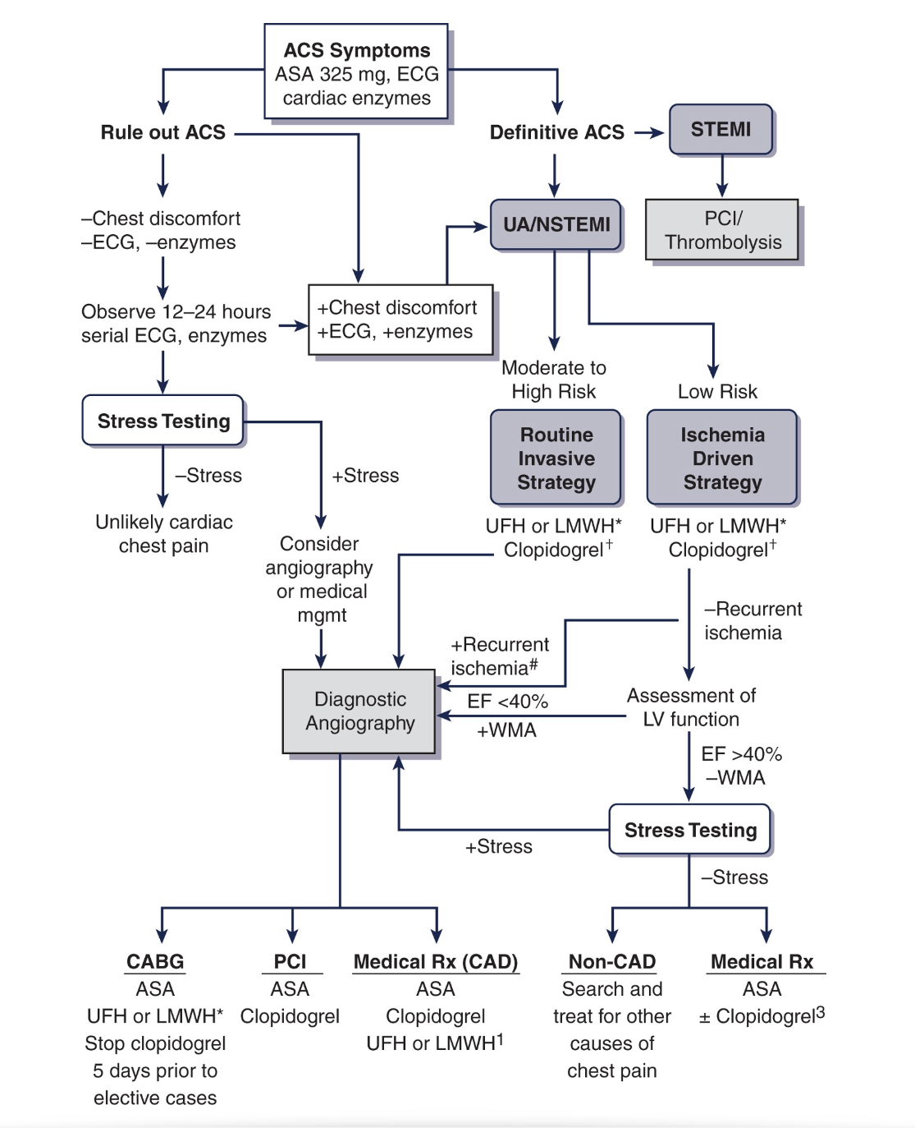
Recurrent, accelerating pain.
TIMI > 3, New HF, New LBBB, VT, New or worsening MR.

Slide 11
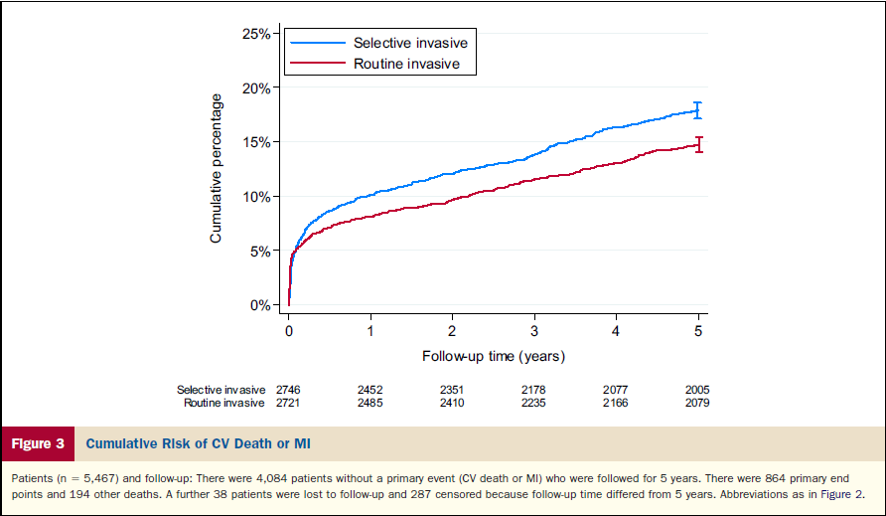
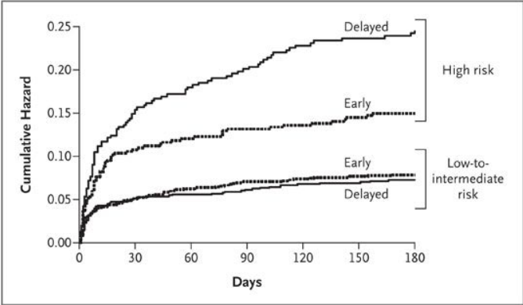
Timing of coronary angiography in UA/NSTEMI
Early Invasive vs Conservative Management of UA/NSTEMI
Early invasive strategy (coronary angiography and myocardial revascularization, as clinically indicated)
Selective invasive strategy (coronary arteriography for recurrent ischemia only).
At a median of 5 years’ follow-up, the routine invasive strategy was associated with a 19% relative risk reduction and 3.2% absolute risk reduction of CV death or nonfatal MI (mainly driven by MI).
10-year outcomes showed no differences between the two groups.
TIMACS Study Early vs. Delayed
Less than 24 hrs vs after 36 hrs
No change at 6 months. Improved outcomes in high risk pts
Notes:
https://doi.org/10.1016/j.jacc.2015.05.051
DOI: 10.1056/NEJMoa0807986

Slide 12
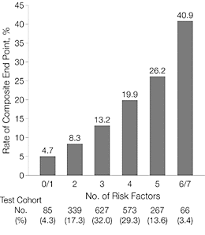
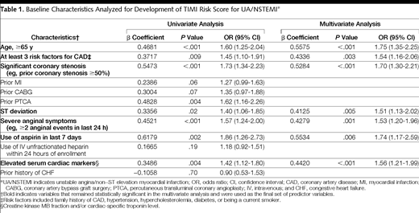
Risk stratification
TIMI Risk Score
Target End Point was All-cause mortality, MI, or urgent revascularization @14d
Notes:
doi:10.1001/jama.284.7.835
Target End Point was All-cause mortality, MI, or urgent revascularization

Slide 13
Long term medical management
STATINS
MIRACL: Atorvastatin 80 mg/d initiated 24 to 96 hours after an acute coronary syndrome, reduces death and nonfatal ischemic events at 16 weeks follow up
14.8% vs 17.4% p=0.048 NNT 38
BETA BLOCKERS
CAPRICORN: Demonstrated that beta-blockers confer considerable benefit in patients suffering from acute myocardial infarction
Carvedilol was associated with a relative risk reduction in all-cause mortality of 23%, but did not reach statistical significance
ACE INHIBITORS
HOPE: Reduced rates of death, MI, and CV in patients with multiple CV risk factors without heart failure NNT 27
SAVED: Captopril in MI with LV dysfunction decreased all-cause mortality by 20%. NNT 20
ALDOSTERONE ANTAGONISTS
EPHESUS: Eplerenone post-MI with LV dysfunction <40%, follow up 16-months
Reduced all-cause mortality by 3% NNT 33
Notes:
DOI:10.1001/jama.285.13.1711
DOI: 10.1056/NEJM199511163332001

